Slide 1


Slide 2

Who is Jesus Christ?
Growing One Verse At A Time

Slide 3
When Jesus came to the region of Caesarea Philippi, he asked his disciples, “Who do people say the Son of Man is?”
Growing One Verse At A Time

Slide 5
In Jesus we have a better person!
Growing One Verse At A Time

Slide 6
In Jesus we have a better high priest!
Growing One Verse At A Time

Slide 7
In Jesus we have a better provision!
Growing One Verse At A Time

Slide 9
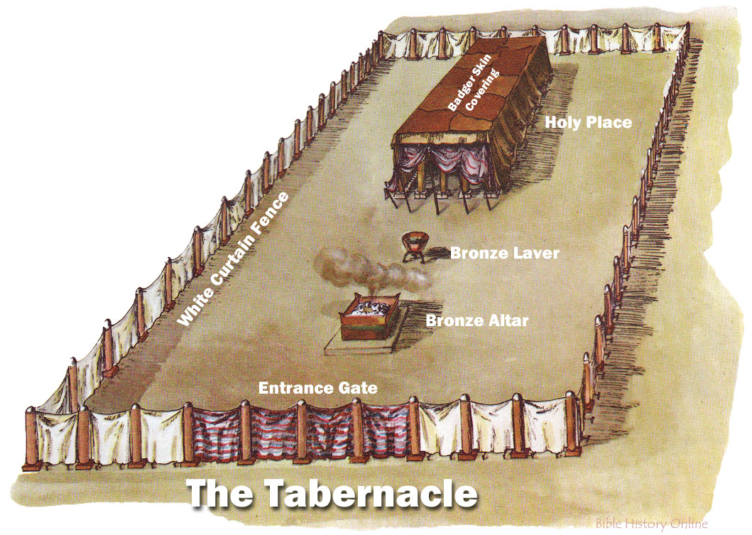
Growing One Verse At A Time

Slide 10
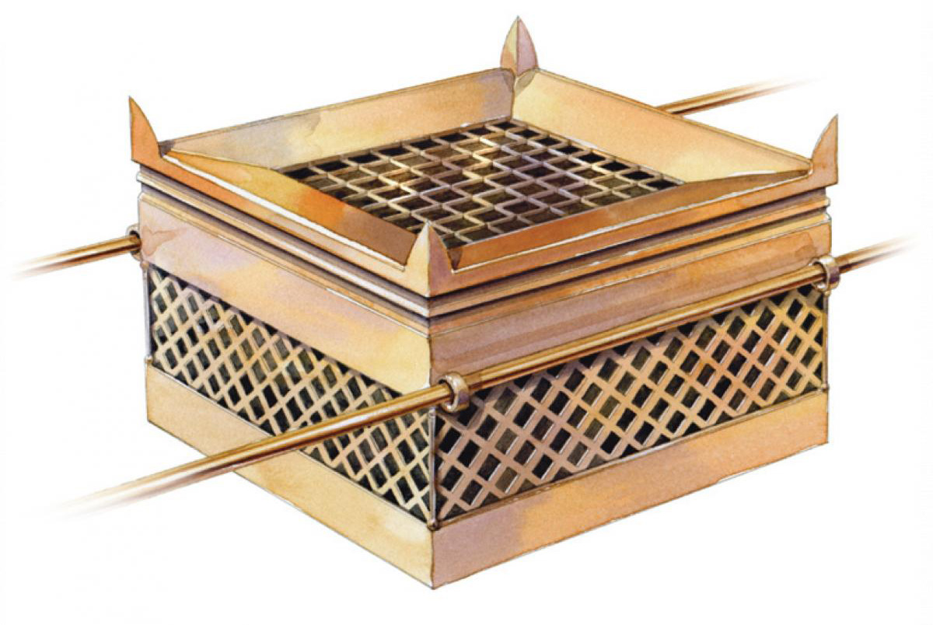
Growing One Verse At A Time

Slide 11
Growing One Verse At A Time

Slide 12
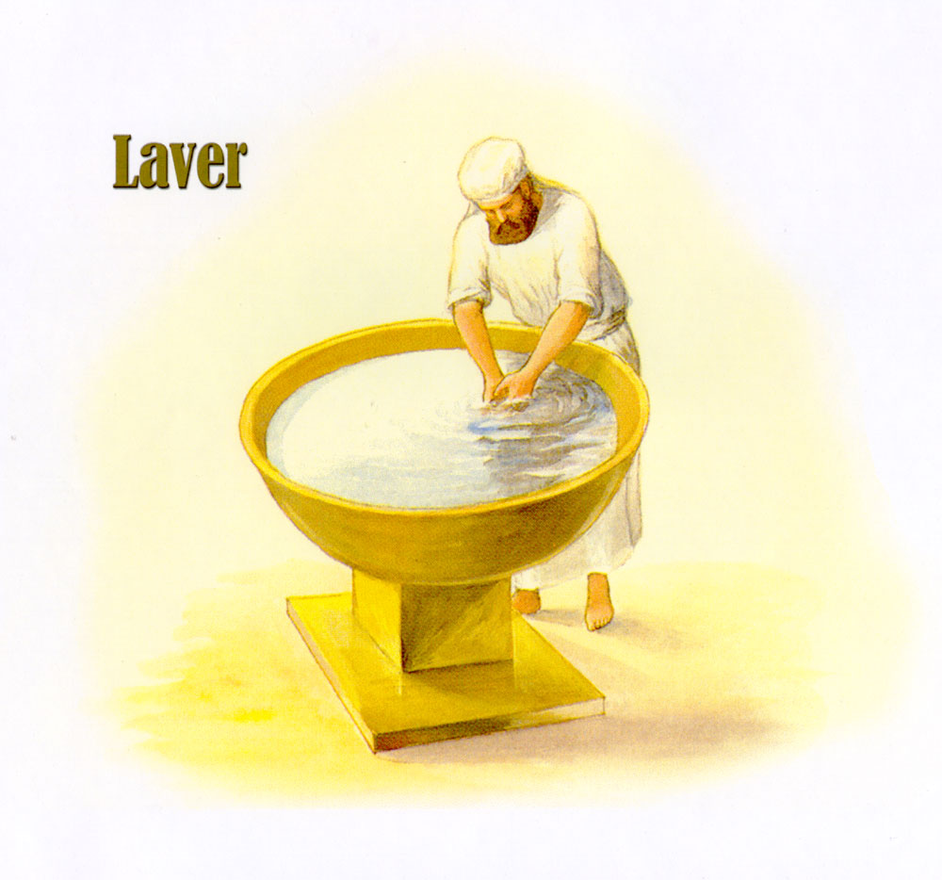
Growing One Verse At A Time

Slide 13
Growing One Verse At A Time

Slide 14
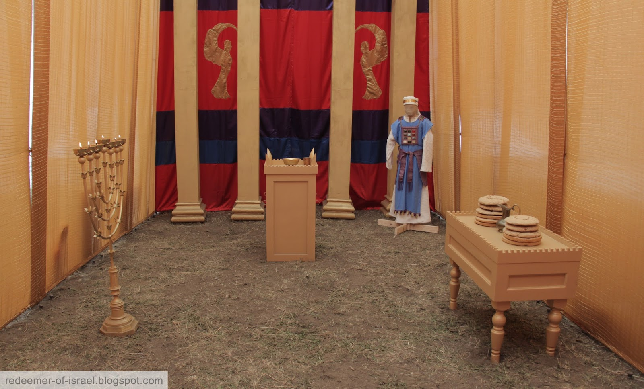
Growing One Verse At A Time

Slide 15
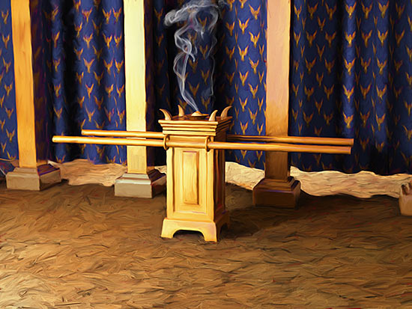
Growing One Verse At A Time

Slide 16
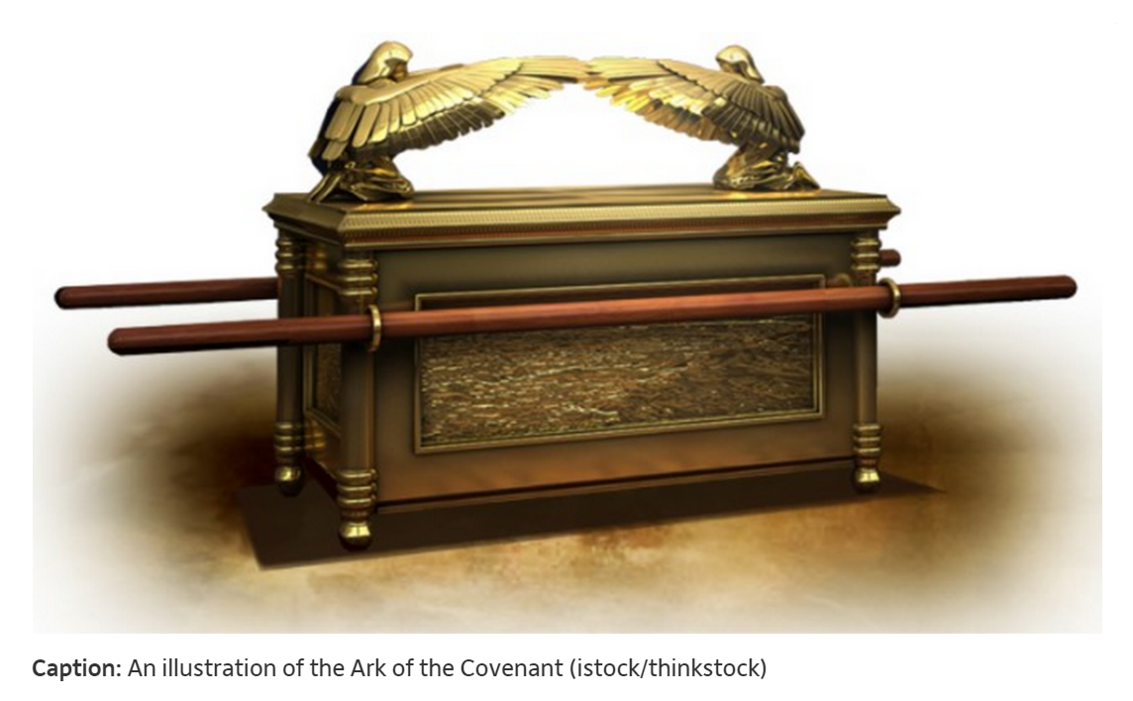
Growing One Verse At A Time

Slide 17
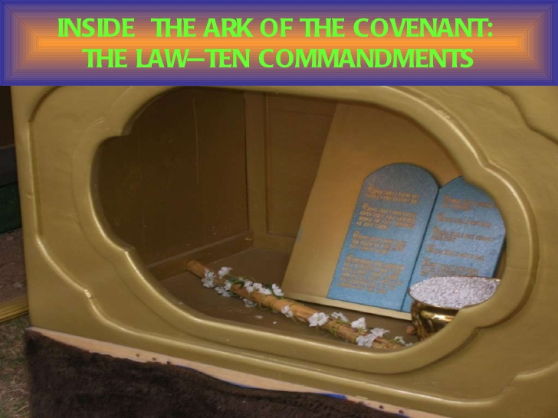
Growing One Verse At A Time

